Slide 1

Project Management Overview
Napoleon Galang

Slide 2
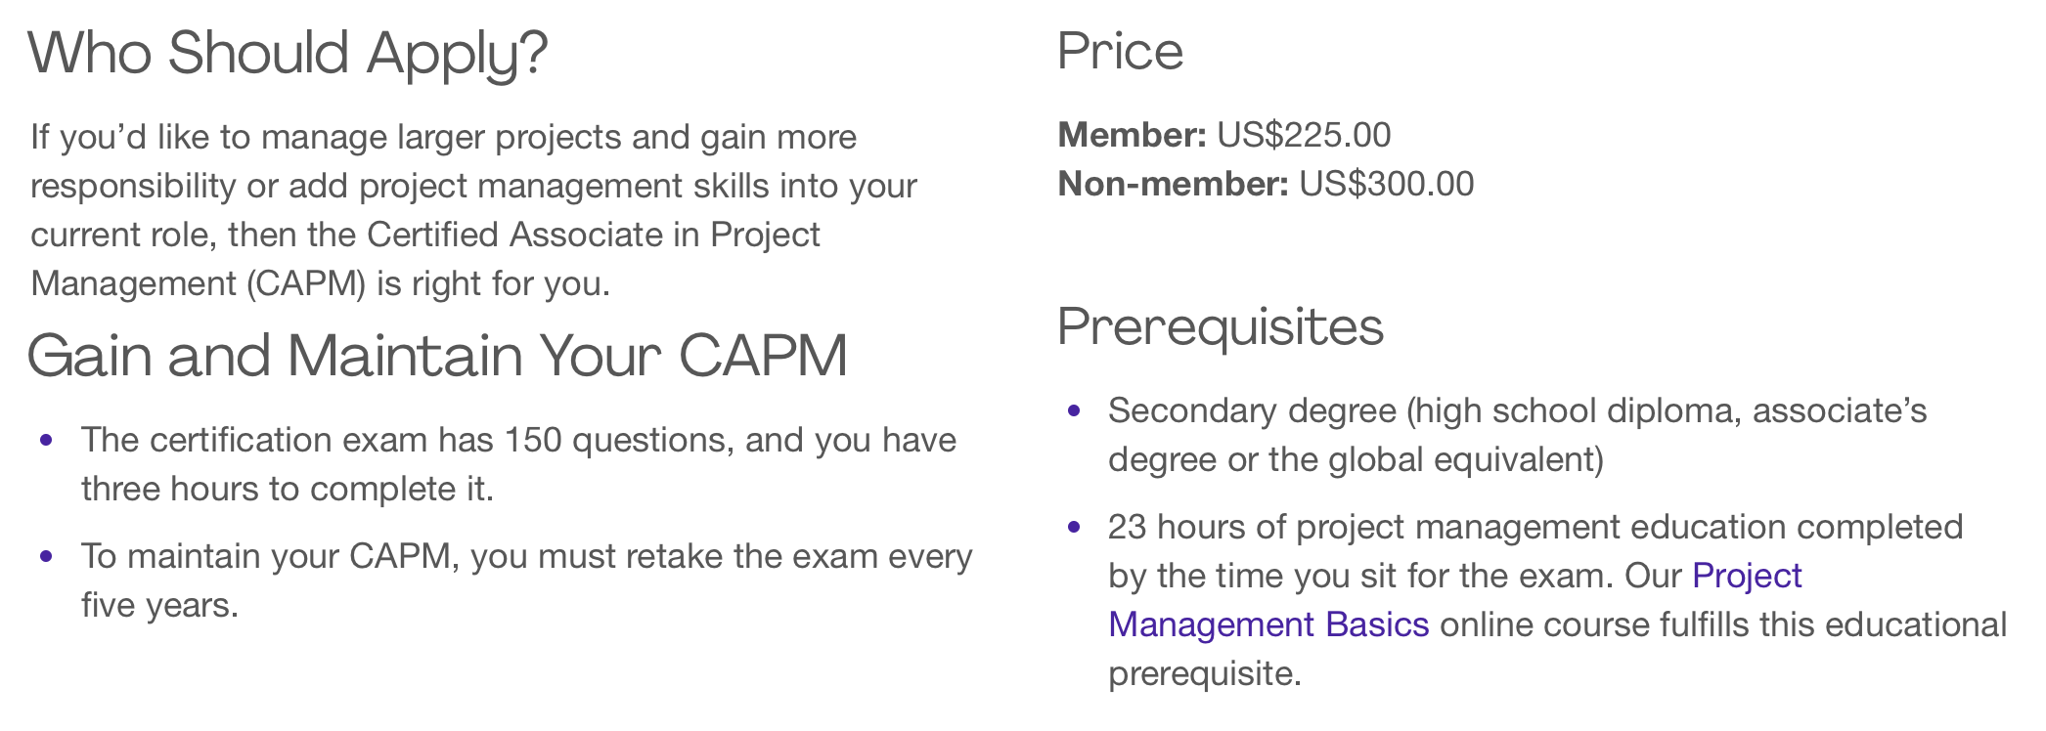
Project 1
Goal: Study for CAPM Certification

Slide 3
What I Learned
Use a variety of resources
Learn the bigger picture of Project Management
Hard knowledge vs. application
Plan moving forward

Slide 4
Project 2
Goal: establish regular pattern in class
Gain experience working in a “team”
Help other students in the class

Slide 5
What I Learned
Assessing quality early is important
Do we actually know our goal?
Dynamic with working with a team
Knowing when to reevaluate project

Slide 6
Project 3
Goal: Learn and build python program
Finish Udemy course on Python
Build program
Working in a bigger team

Slide 7
What I Learned
Scoping and planning
Planning responses for risks
Deliverables / outcomes
Bigger team dynamic

Slide 8
Project 4
Goal: gather useful data about course
Apply data analysis skills
Benefit instructor and students
Present findings

Slide 9
What I Learned
Learning from past mistakes
Meeting deadlines
Understanding overall goal
Assessing quality throughout

Slide 10
Self Evaluation
Grade
BYU-I Learning Model
Reflections
Time Tracking
5 Outcomes

Slide 11
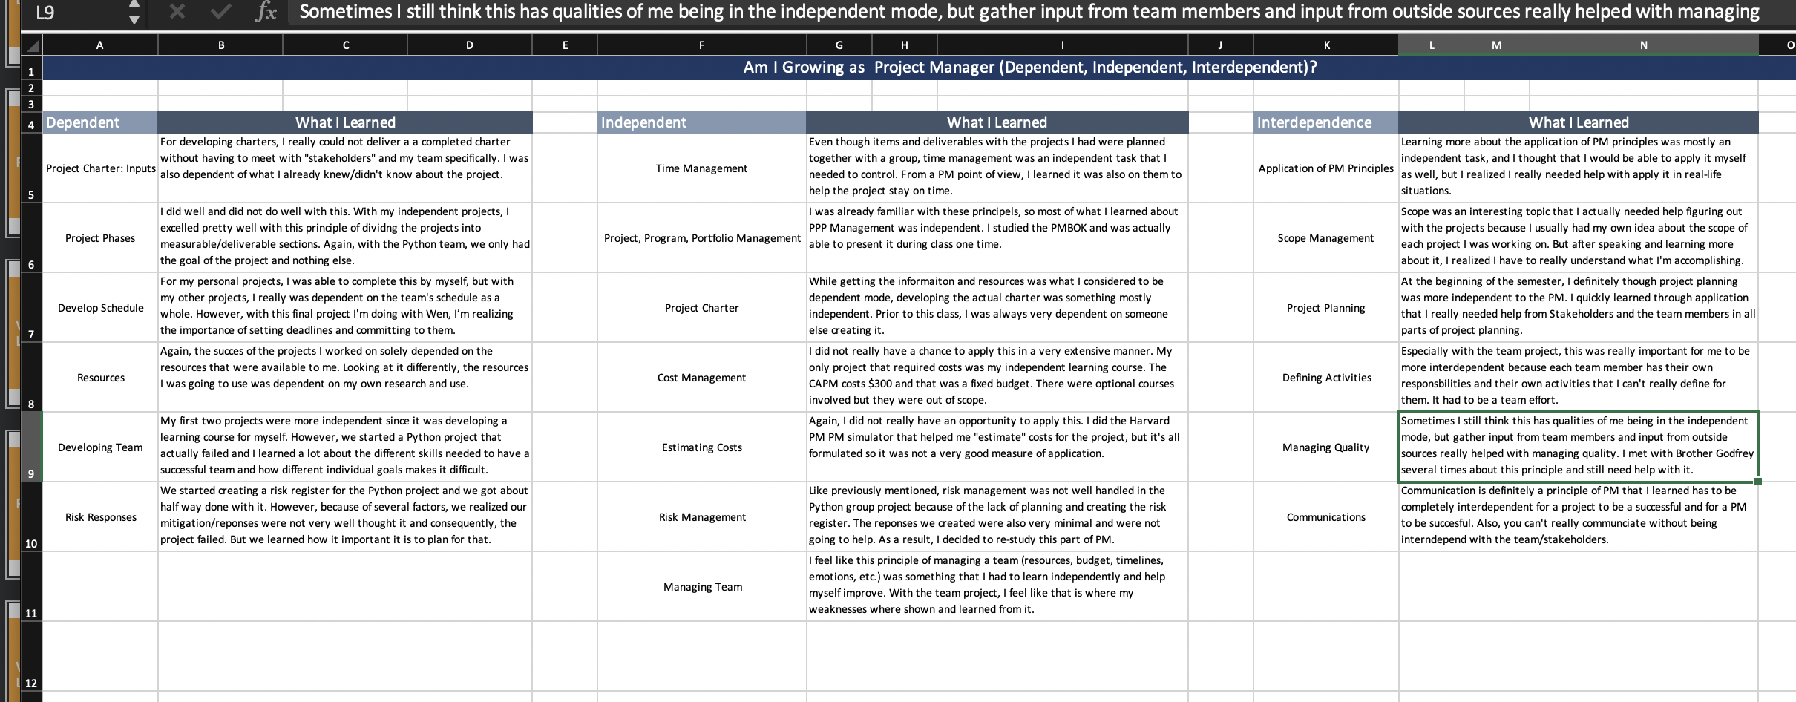

Slide 12
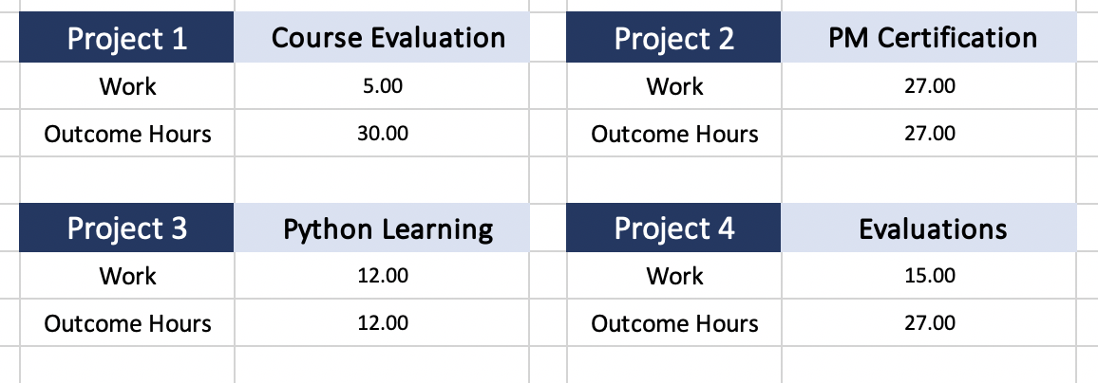

Slide 13
